Slide 1
Assessing model accuracy
Chapter 02 – Part II

Slide 2
Outline
Assessing Model Accuracy
Measuring the Quality of Fit
The Bias-Variance Trade-off
The Classification Setting

Slide 3
Measuring Quality of Fit
Suppose we have a regression problem.
One common measure of accuracy is the mean squared error (MSE) i.e.
Where is the prediction our method gives for the observation in our training data.

Slide 4
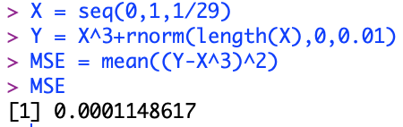

Exercises
Calculate the MSE of the following data.
Observed data:
$$Y=X^{3}+ε, ε\sim N\left(0,0.01\right), n=30,X∈[0,1]$$
Model:
$$Y=X^{3}$$

Slide 5
A Problem
In either case (prediction and inference) our method has generally been designed to make MSE small on the training data we are looking at e.g. with linear regression we choose the line such that MSE is minimized.
What we really care about is how well the method works on new data. We call this new data “Test Data”.
There is no guarantee that the method with the smallest training MSE will have the smallest test (i.e. new data) MSE.

Slide 6
Training vs. Test MSE’s
In general the more flexible a method is the lower its training MSE will be i.e. it will “fit” or explain the training data very well.
Side Note: More Flexible methods (such as splines) can generate a wider range of possible shapes to estimate f as compared to less flexible and more restrictive methods (such as linear regression). The less flexible the method, the easier to interpret the model. Thus, there is a trade-off between flexibility and model interpretability.
However, the test MSE may in fact be higher for a more flexible method than for a simple approach like linear regression.

Slide 7
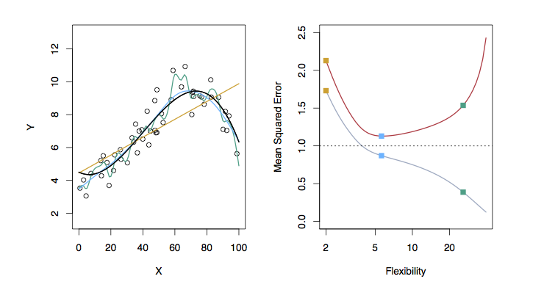
Examples with Different Levels of Flexibility: Example 1
LEFT
Black: Truth
Orange: Linear Estimate
Blue: smoothing spline
Green: smoothing spline (more flexible)
RIGHT
RED: Test MSE
Grey: Training MSE
Dashed: Minimum possible test MSE (irreducible error)

Slide 8
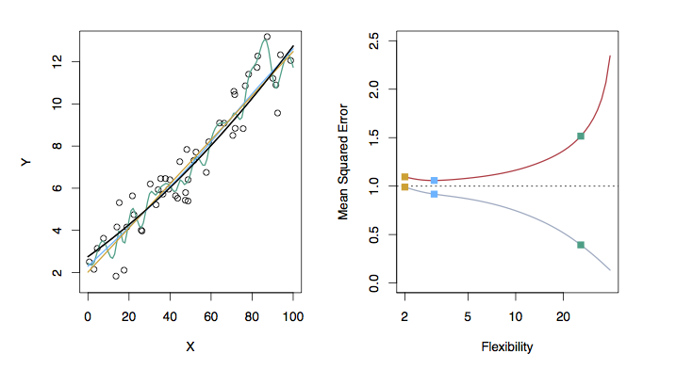
Examples with Different Levels of Flexibility: Example 2
LEFT
Black: Truth
Orange: Linear Estimate
Blue: smoothing spline
Green: smoothing spline (more flexible)
RIGHT
RED: Test MES
Grey: Training MSE
Dashed: Minimum possible test MSE (irreducible error)

Slide 9
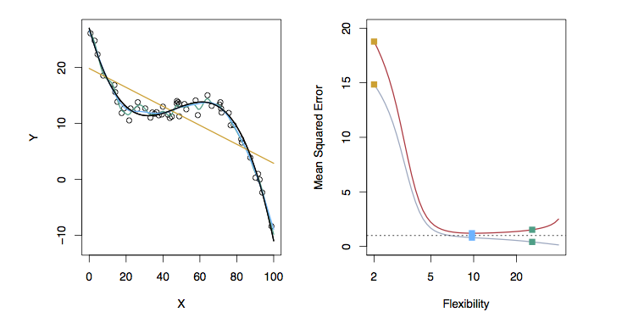
Examples with Different Levels of Flexibility: Example 3
LEFT
Black: Truth
Orange: Linear Estimate
Blue: smoothing spline
Green: smoothing spline (more flexible)
RIGHT
RED: Test MES
Grey: Training MSE
Dashed: Minimum possible test MSE (irreducible error)

Slide 10
Bias/ Variance Tradeoff
The previous figures of test versus training MSE’s illustrates a very important tradeoff that governs the choice of statistical learning methods.
There are always two competing forces that govern the choice of learning method i.e. bias and variance.

Slide 11
Bias of Learning Methods
Bias refers to the error that is introduced by modeling a real life problem (that is usually extremely complicated) by a much simpler problem.
For example, linear regression assumes that there is a linear relationship between Y and X. It is unlikely that, in real life, the relationship is exactly linear so some bias will be present.
The more flexible/complex a method is the less bias it will generally have.

Slide 12
Variance of Learning Methods
Variance refers to how much your estimate for f would change by if you had a different training data set.
Generally, the more flexible a method is the more variance it has.

Slide 13
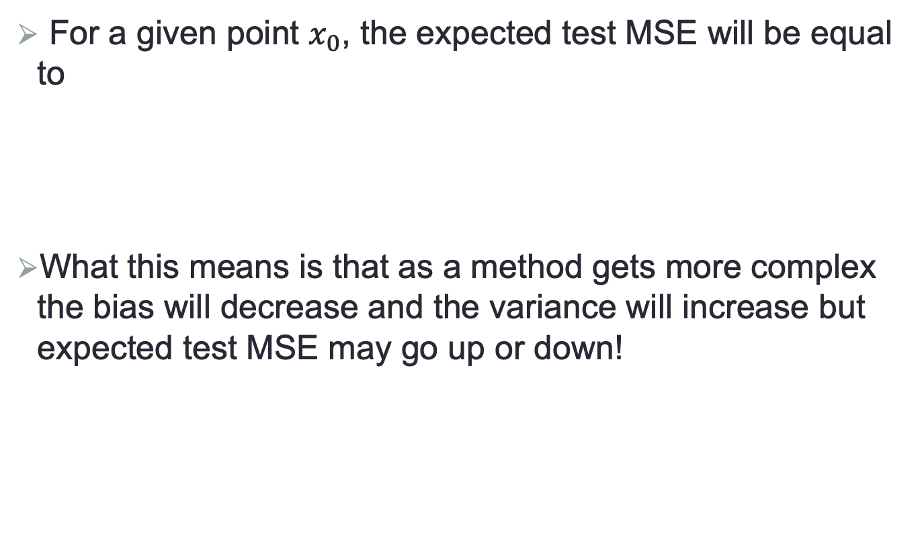
The Trade-off
For a given point $x_{0}$, the expected test MSE will be equal to
What this means is that as a method gets more complex the bias will decrease and the variance will increase but expected test MSE may go up or down!

Slide 14







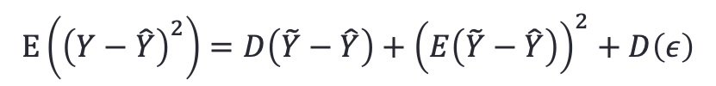


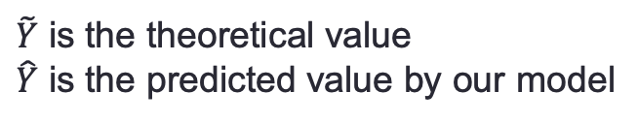


Proof of Expected Test MSE (optional)
$$Y=\tilde{Y}+ε$$
$\tilde{Y}$ is the theoretical value
$\hat{Y}$ is the predicted value by our model
$$Y=\tilde{Y}−\hat{Y}+\hat{Y}+ε$$
$$Y−\hat{Y}=\tilde{Y}−\hat{Y}+ε$$
$$E\left({\left(Y−\hat{Y}\right)}^{2}\right)=E\left({\left(\tilde{Y}−\hat{Y}+ε\right)}^{2}\right)$$
$$=E\left({\left(\tilde{Y}−\hat{Y}\right)}^{2}\right)+E\left(2ε\left(\tilde{Y}−\hat{Y}\right)\right)+E\left(ε^{2}\right)$$
If $E\left(ε\right)=0$, then
$$E\left({\left(Y−\hat{Y}\right)}^{2}\right)=E\left({\left(\tilde{Y}−\hat{Y}\right)}^{2}\right)+E(ε^{2})$$
Given $D\left(X\right)=E\left(X^{2}\right)−E^{2}\left(X\right)$, we have
$$E\left({\left(Y−\hat{Y}\right)}^{2}\right)=D\left(\tilde{Y}−\hat{Y}\right)+{\left(E\left(\tilde{Y}−\hat{Y}\right)\right)}^{2}+D\left(ε\right)$$
$$Variance$$
$$Bias^{2}$$
$$Irreducible error$$

Slide 15
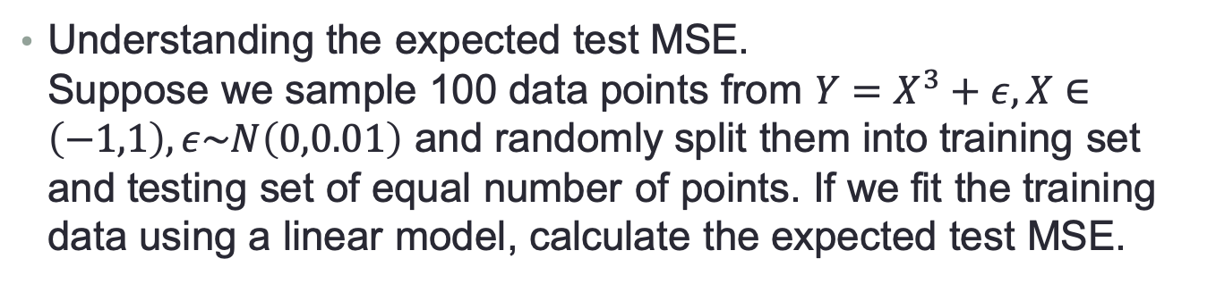
Example
Understanding the expected test MSE. Suppose we sample 100 data points from $Y=X^{3}+ε, X∈\left(−1,1\right), ε\sim N\left(0,0.01\right)$ and randomly split them into training set and testing set of equal number of points. If we fit the training data using a linear model, calculate the expected test MSE.
Generate 100 data points from the above function.
Split them into two sets.
Fitting the training data of a linear model.
Calculate the Bias.
Calculate the Variance.
Calculate the irreducible error.

Slide 16


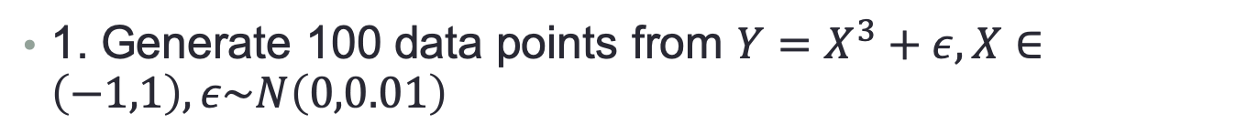
1. Generate 100 data points from $Y=X^{3}+ε, X∈\left(−1,1\right), ε\sim N\left(0,0.01\right)$
or
Note:
will generate 101 data points
You can use R Help to find the usage of a function in R.

Slide 17
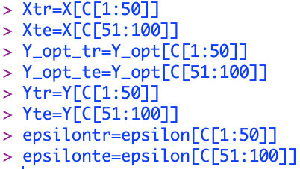
2. Split X and Y into two groups of equal number of points.
As our data are generated by ourselves, we can directly generate two groups of points instead. However, in real applications, splitting datasets are necessary. Therefore, we demonstrate here how to split dataset in R.
Step 1: generate a random permutation for indices.
Step 2: Split X and Y.

Slide 18

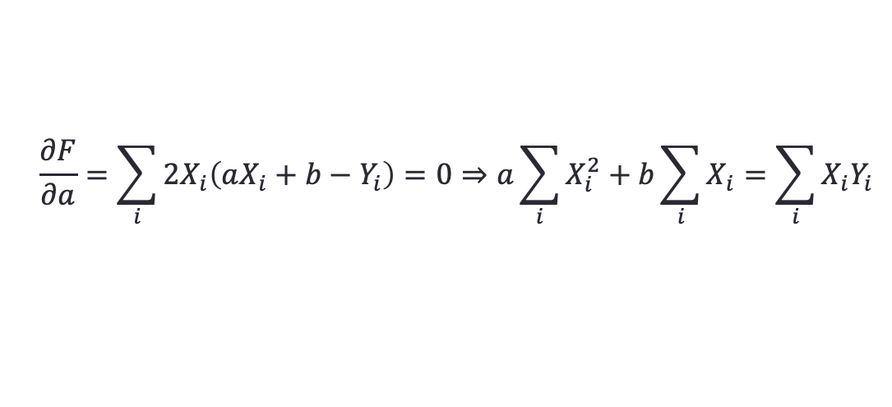
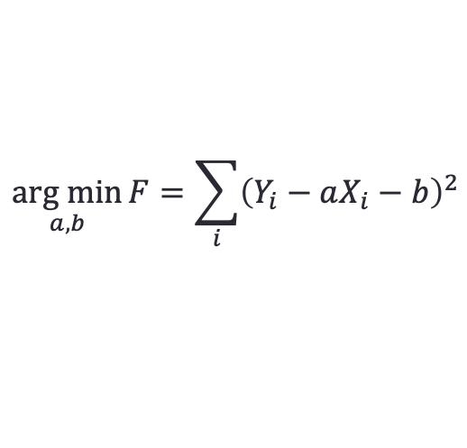
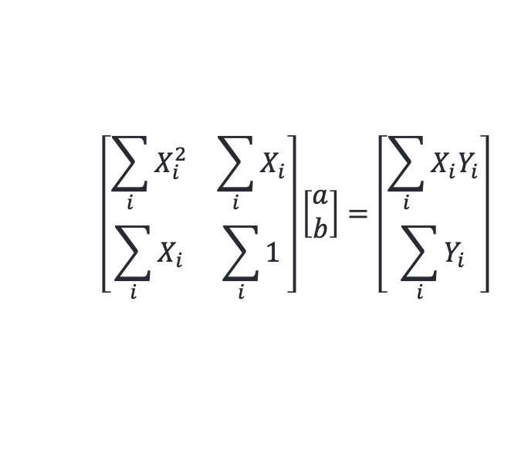
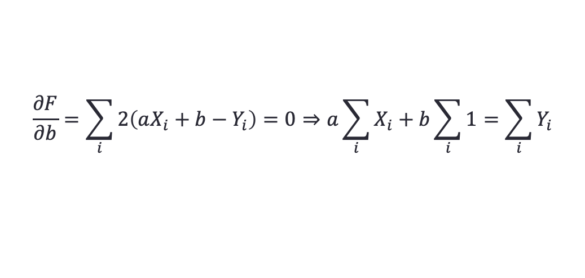
3. Fitting the data using a linear model
Minimize the following function by setting the first-order partial derivatives to 0.
$$\underset{a,b}{arg min}{F=\sum_{i}{{\left(Y_{i}−aX_{i}−b\right)}^{2}}}$$
$$\frac{∂F}{∂a}=\sum_{i}{{2X}_{i}\left(aX_{i}+b−Y_{i}\right)=0}⇒a\sum_{i}{X_{i}^{2}}+b\sum_{i}{X_{i}}=\sum_{i}{X_{i}Y_{i}}$$
$$\frac{∂F}{∂b}=\sum_{i}{2\left(aX_{i}+b−Y_{i}\right)=0}⇒a\sum_{i}{X_{i}}+b\sum_{i}{1}=\sum_{i}{Y_{i}}$$
$$\left[\begin{matrix}\sum_{i}{X_{i}^{2}} & \sum_{i}{X_{i}} \\ \sum_{i}{X_{i}} & \sum_{i}{1}\end{matrix}\right]\left[\begin{matrix}a \\ b\end{matrix}\right]=\left[\begin{matrix}\sum_{i}{X_{i}Y_{i}} \\ \sum_{i}{Y_{i}}\end{matrix}\right]$$

Slide 19

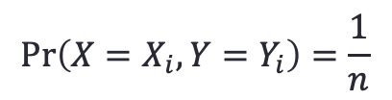

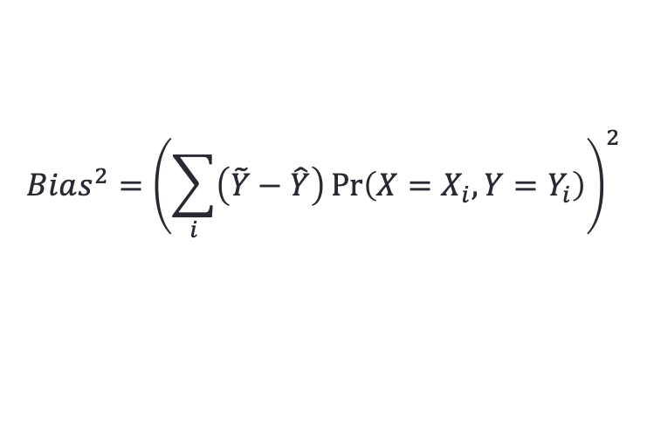


4. Calculate Bias.
For a data point $x_{0}$ in testing set, the bias is
$$\hat{Y}−Y$$
Predictions of the model
Groundtruth
$$\hat{Y}=aX+b$$
$$\tilde{Y}=X^{3}$$
To calculate the expected MSE, we assume the data points in testing set are uniformly distributed.
$$Bias^{2}={\left(\sum_{i}{\left(\tilde{Y}−\hat{Y}\right)\operatorname{Pr}\left(X=X_{i},Y=Y_{i}\right)}\right)}^{2}$$
$$\operatorname{Pr}\left(X=X_{i},Y=Y_{i}\right)=\frac{1}{n}$$
5. Calculate Variance
6. Calculate irreducible error, i.e. variance of noise

Slide 20
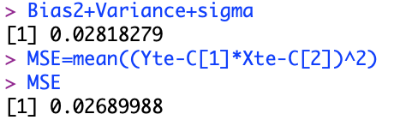


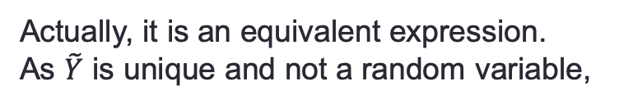
What is the different between the example and the definition of expected MSE?
We only train the model once. However, to compute the expected mean square error, we need train on different training data many times and compute the mean squared errors on a fixed testing datum and finally compute the expectation. Nevertheless, we use different testing data to simulate this process.
On our text book, the expected mean squared error is computed by:
Actually, it is an equivalent expression.
As $\tilde{Y}$ is unique and not a random variable,
$$Var\left(\hat{f}\left(x_{0}\right)\right)=D\left(\hat{Y}\right)=D(\hat{Y}−\tilde{Y})$$
$Bias{\left(\hat{f}\left(x_{0}\right)\right)}^{2}$ has the same definition as ours.

Slide 21
The Classification Setting
For a regression problem, we used the MSE to assess the accuracy of the statistical learning method
For a classification problem we can use the error rate i.e.
is an indicator function, which will give 1 if the condition is correct, otherwise it gives a 0.
Thus the error rate represents the fraction of incorrect classifications, or misclassifications

Slide 22
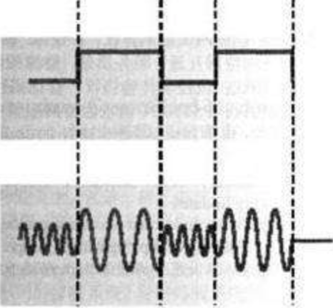

Bayes Classifier
A classifier assign a test observation x to class j for which
$$Pr⁡(Y=j|X=x)$$
is largest.
Suppose we are senior members of Earth Three-Body Organization (ETO) and we want to receive instructions from our God. God sends us digital signal and a electromagnetic wave of high frequency indicates 0, while one of low frequency indicates 1.
Without disturbance, like cosmic rays and dust, we can receive “clean” signals. However, they are more than 4 light year far from us. The received signals contain lots of noises.

Slide 23








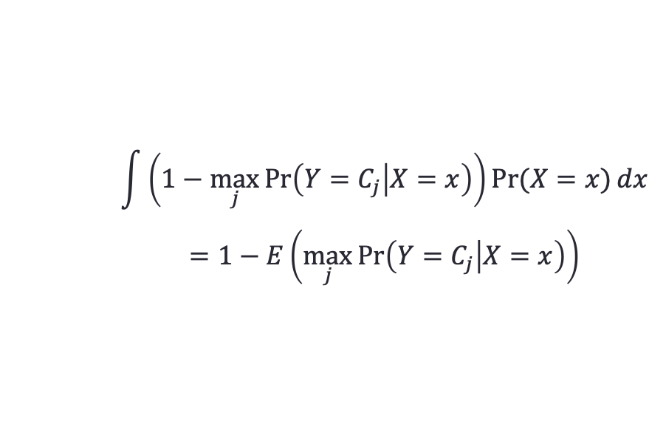
Bayes Classifier
$$C_{0}$$
$$C_{1}$$
$$C_{0}$$
$$C_{1}$$
$$x$$
Bayes Classifier
$$\max_{j} Pr\left({Y=C}_{j} | X=x\right)$$
Bayes Error Rate for $x$
$$1−\max_{j}{Pr⁡({Y=C}_{j}|X=x)}$$
$$\int{\left(1−\max_{j}{\operatorname{Pr}\left({Y=C}_{j} | X=x\right)}\right)\operatorname{Pr}{(X=x)}dx}$$
$$=1−E\left(\max_{j}{\operatorname{Pr}\left(Y=C_{j} | X=x\right)}\right)$$
Bayes Error Rate
Given that $∫{\operatorname{Pr}\left(X=x\right)=1, E\left(g\left(X\right)\right)=∫g\left(x\right)f\left(x\right)dx}$, where $f(x)$ is the probability density function of random Variable X.

Slide 24
Bayes Error Rate
The Bayes error rate refers to the lowest possible error rate that could be achieved if somehow we knew exactly what the “true” probability distribution of the data looked like.
On test data, no classifier (or stat. learning method) can get lower error rates than the Bayes error rate.
Of course in real life problems the Bayes error rate can’t be calculated exactly.

Slide 25
K-Nearest Neighbors (KNN)
k Nearest Neighbors is a flexible approach to estimate the Bayes Classifier.
For any given X we find the k closest neighbors to X in the training data, and examine their corresponding Y.
If the majority of the Y’s are orange we predict orange otherwise guess blue.
The smaller that k is the more flexible the method will be.

Slide 26
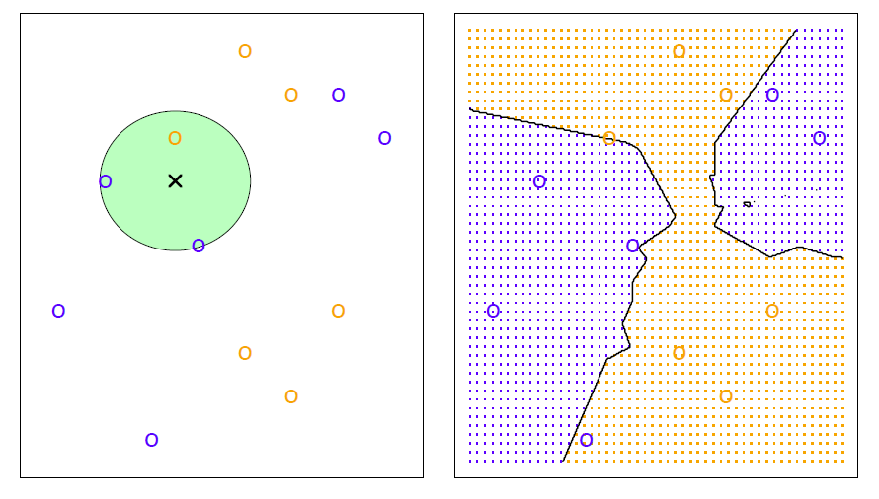
KNN Example with k = 3

Slide 27
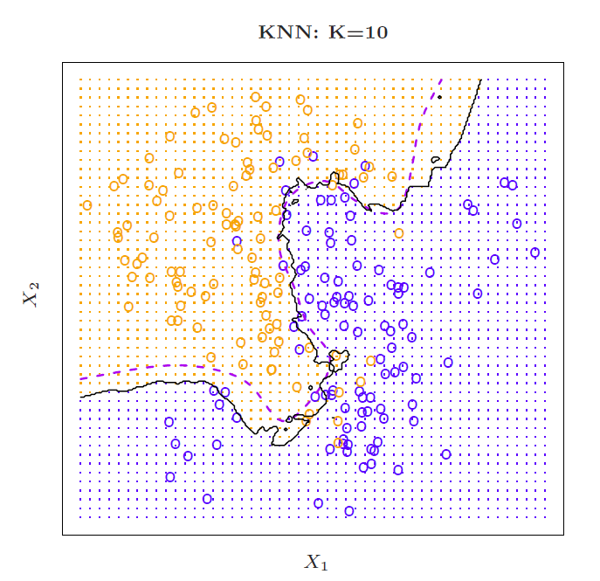
Simulated Data: K = 10

Slide 28
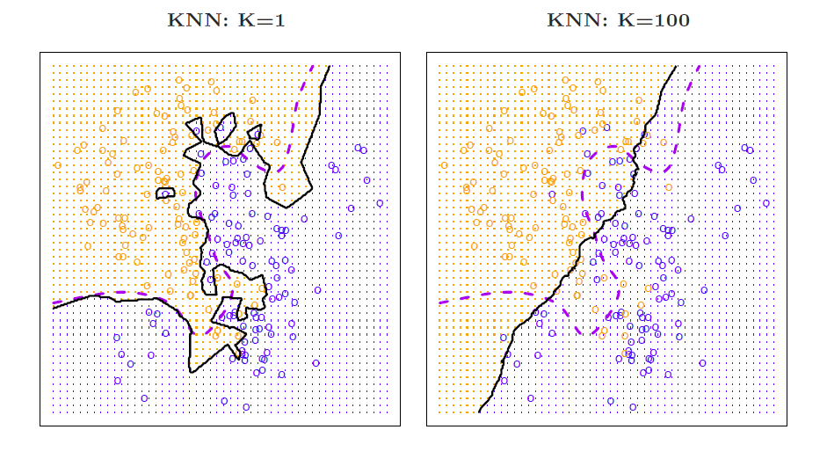
K = 1 and K = 100

Slide 29
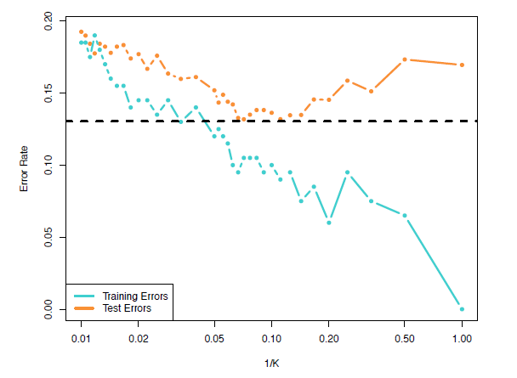
Training vs. Test Error Rates on the Simulated Data
Notice that training error rates keep going down as k decreases or equivalently as the flexibility increases.
However, the test error rate at first decreases but then starts to increase again.

Slide 30
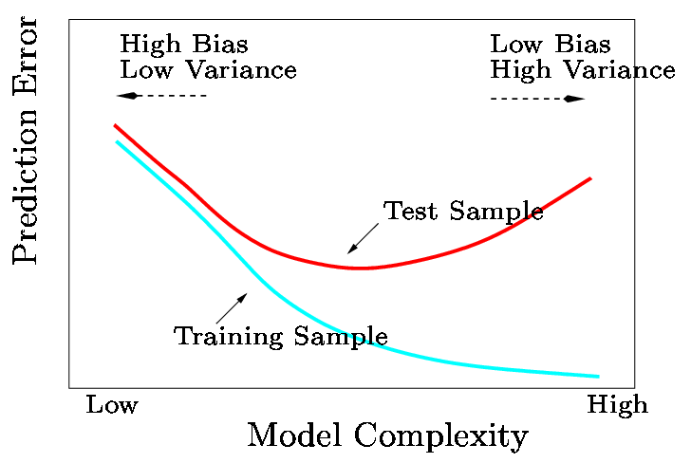
A Fundamental Picture
In general training errors will always decline.
However, test errors will decline at first (as reductions in bias dominate) but will then start to increase again (as increases in variance dominate).
We must always keep this picture in mind when choosing a learning method. More flexible/complicated is not always better!

Slide 31

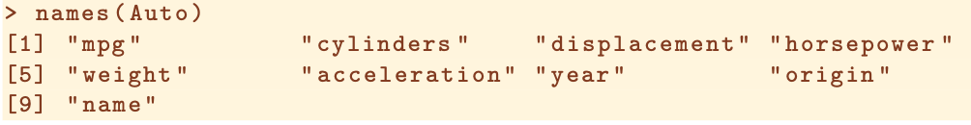
Read and Write Data in R
Read .data file
Use ? to represent a missing data
T is short for TRUE. header=T means the first line contains variable names
Read .csv file
.csv file is a widely-used file format for storing data. It can be read by lots of software, such as MS Excel, MacOS Numbers, WPS.
In R, we use the following function to read .csv file

Slide 32
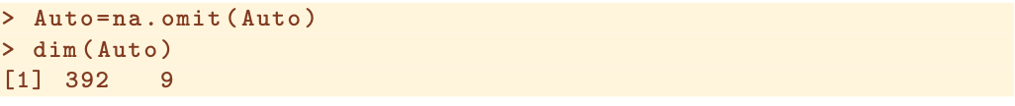

Read and Write Data in R
Remove items with missing data
Access each variable
Interactive tool: identify()
Data information summarization: identify()

Slide 33

list, data.frame, as.factor
List is similar to class in C++ or python. It is a collection of objects with names.
From the above codes, we get a list of two objects named ‘name’ and ‘title’ each of which is a concatenation of two strings.
data.frame() creates data frames, tightly coupled variables sharing most properties with list and matrix.
as.factor() convert a vector of string or number to categorical variable

Slide 34
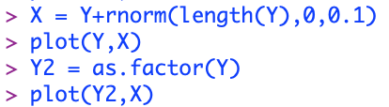
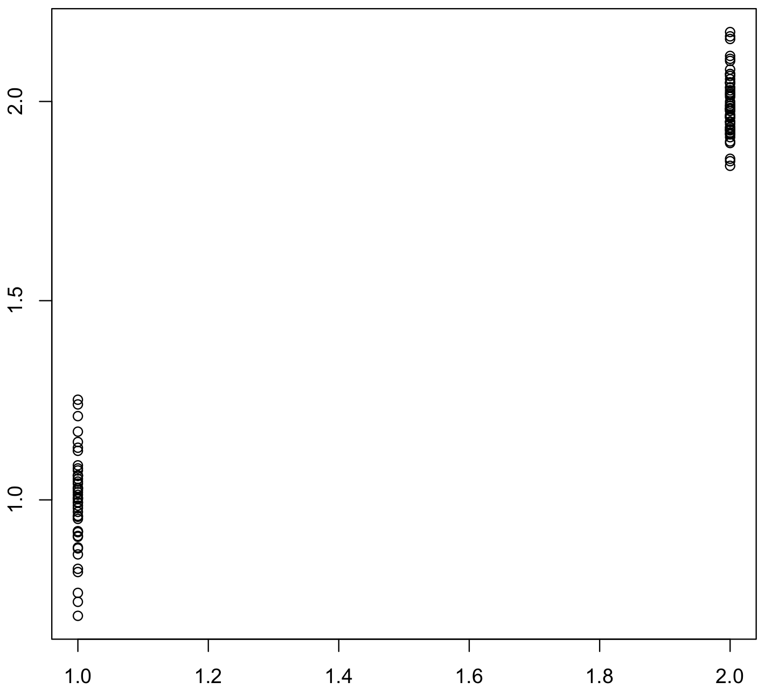
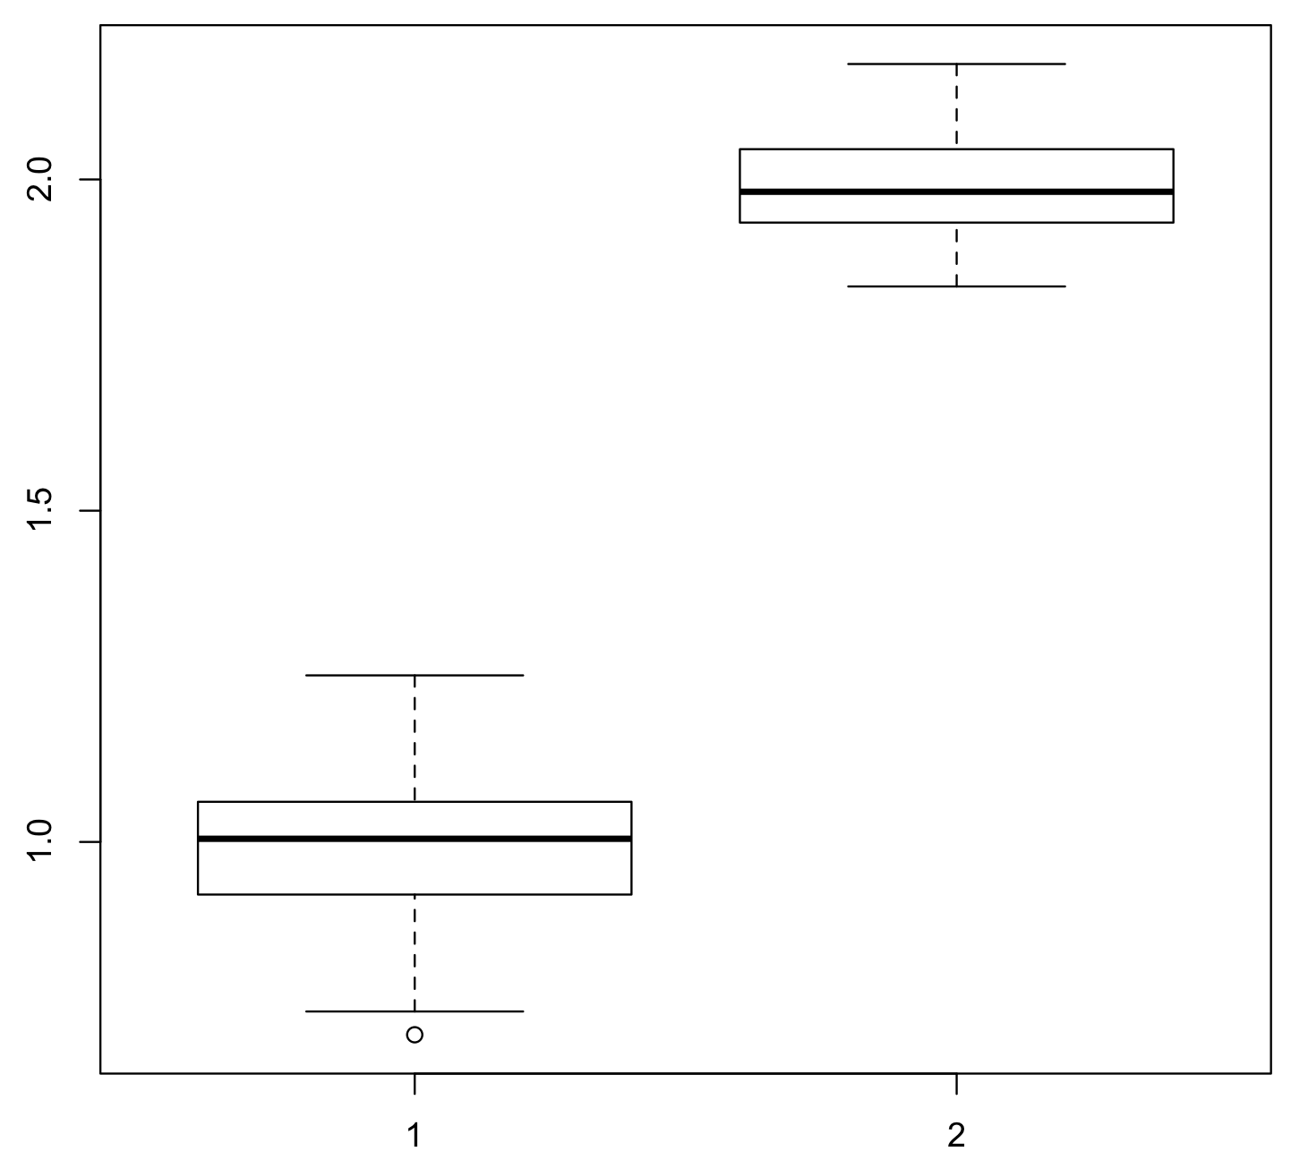

Slide 35
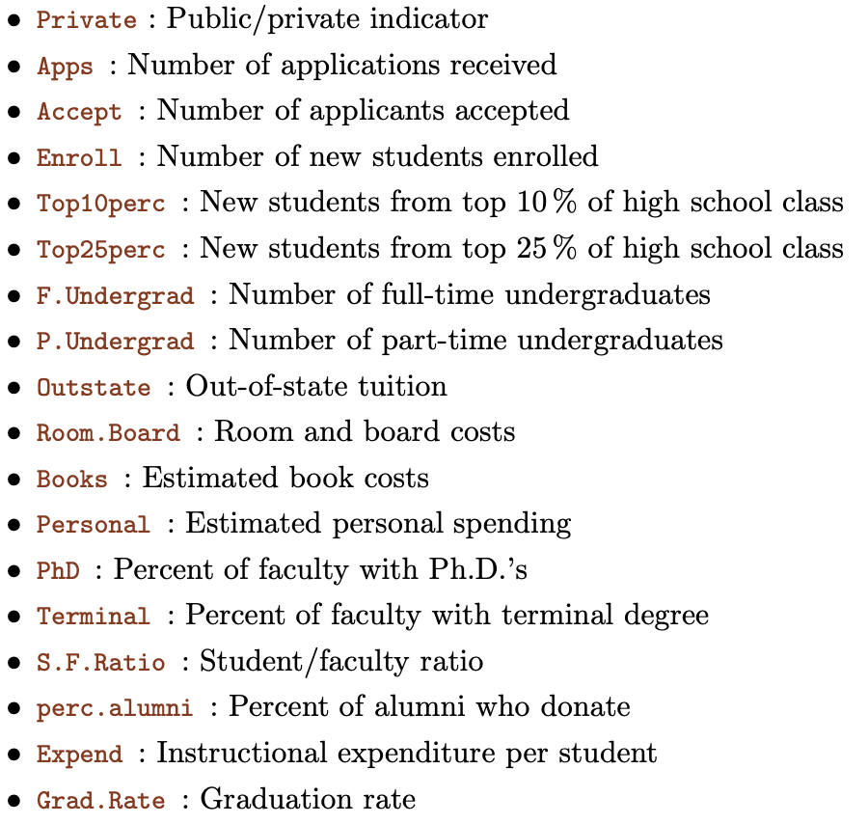
Example: college.csv

Slide 36
Example: college.csv
Load college.csv
Remove the variable “college names”
Summary the dataset.
Add a new variable “Elite” to specify whether more than 50% students are from top 10% high school.
Draw four histograms of four variables in a single figure. (par(mfrow=c(2,2))
Write the new college data to new file college2.csv

Slide 37
Summary
1. Mean squared error
2. Flexibility
3. Bias/Variance Tradeoff
4. Bayes Error Rate
5. K-Nearest Neighbors (KNN)
6. Read, write and manipulate data in R
Assignment
P. 53, 7; P. 56, 9;
Due: This weekend

